Slide 1

Chess Party
Presenters:
Jayden Alonzo-Estrada,
Layton Tobin,
Cameron Hockins

Slide 2

The Timeless Game of Chess
Played for millennia
Test of Mental Strength and Character
Many variants exist
All too hard

Slide 3
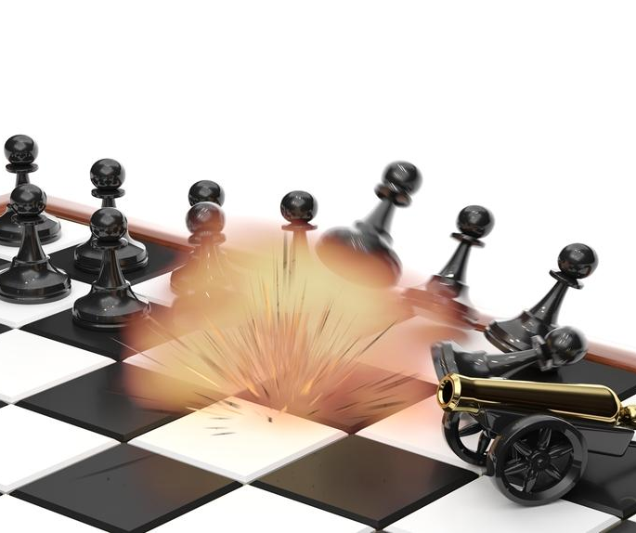
Introducing Chess Party
Chess (Skill) x Mario Party (Random)
Tactical Brilliance? No
Universal Randomness? Yes
Start with normal game of chess
Each turn induces a random event

Slide 4
Key Benchmarks of Project
Make
Make chess in Python
Modularize
Modularize chess to have full control of everything
Separate each piece, board square, rule, and event
Create
Come up with random events
Every piece has a chance to become a queen
Every piece has a chance to become frozen for X turns
Control
Have everything be configurable
Induce more or less chaos/randomness
Expandable
Make it easily expandable (Modding/DLCs)

Slide 5
Benchmarks Cont.
Make Chess — Surprisingly Difficult
Stores game state in GUI with pygame
Modularize Chess — Easy
More CPU/RAM usage, but inconsequential
Create Events — Easy
Good modularization = easy event making
Configurable — Easy
Matter of replacing everything with variables and percentages
Expandable — Easy
Matter of adding to events module

Slide 6
Design Patterns
Observer
The Event Watcher (Pygame)
Singleton
Board
Separate each piece, board square, rule, and event
State
ChessPiece
Frozen
Promotion
Is in the game

Slide 7


Project Upkeep & Communication
We used:
Discord – Communication
GitHub – Manage project and branches
Branch for each member (*)
Push to main with final changes

Slide 8
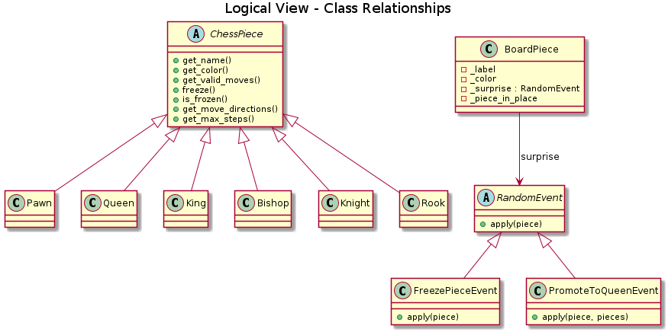
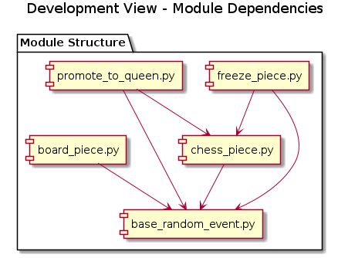
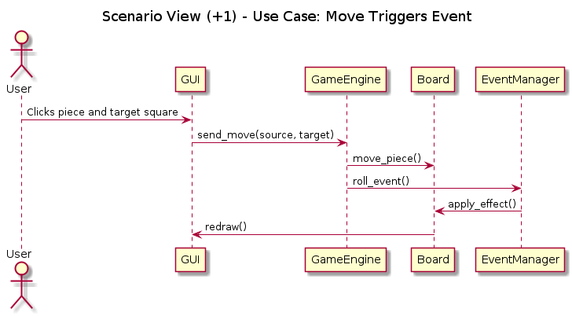
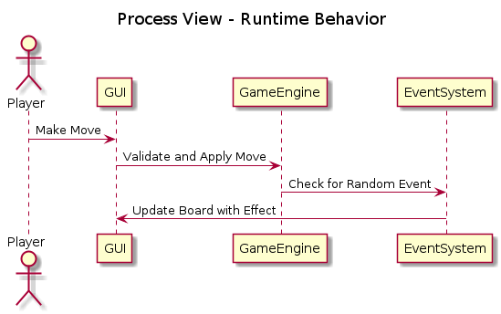
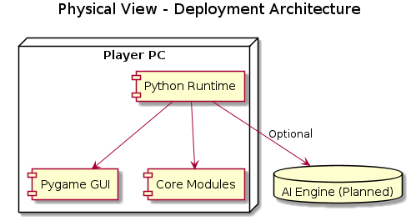
4+1

Slide 9
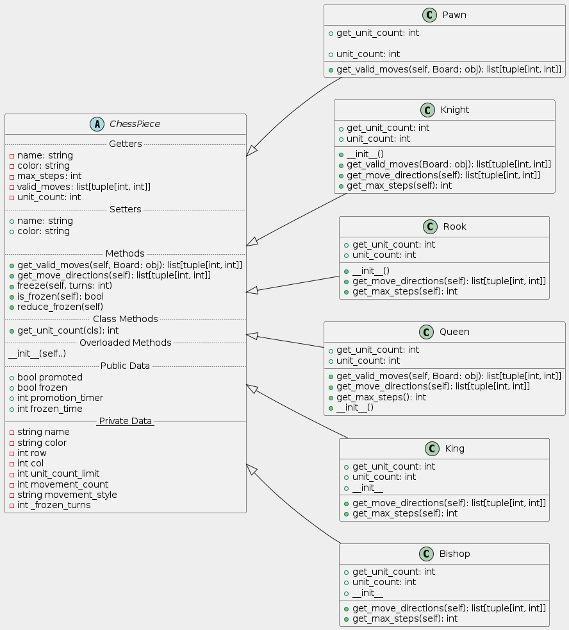
ChessPiece classes
Abstract ChessPiece class
Inheritance
Overloaded methods
Each piece is different

Slide 10
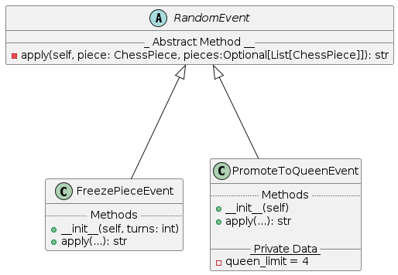
Event Classes

Slide 11
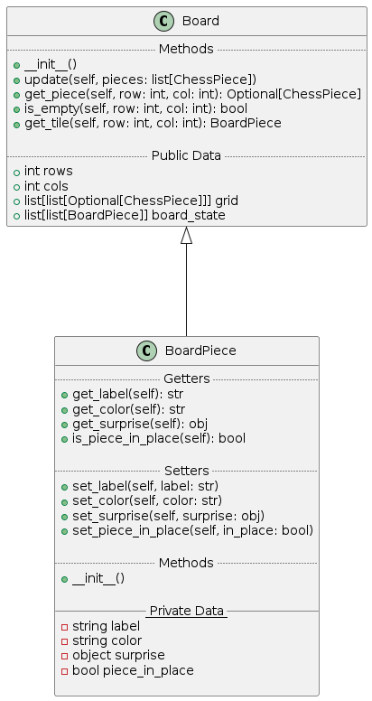
Board Classes

Slide 12
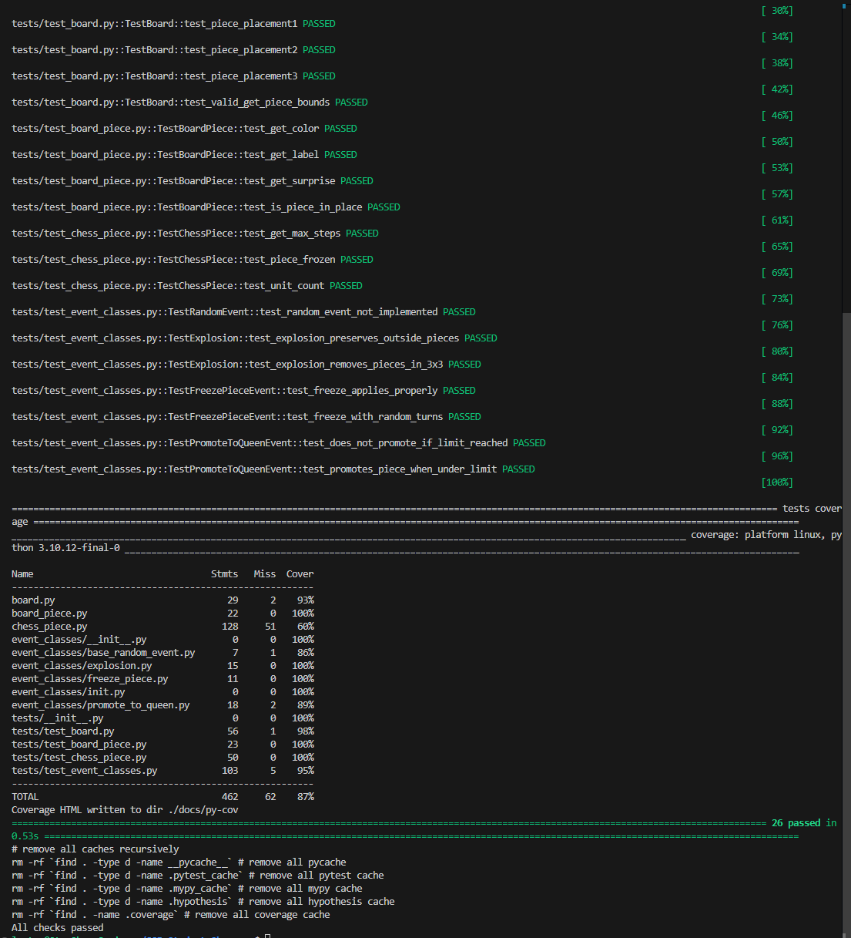
Testing & Formatting
Unittests
Mock
Hypothesis
Flake8
Autopep8
Makefile
Modules, classes, packages

Slide 13
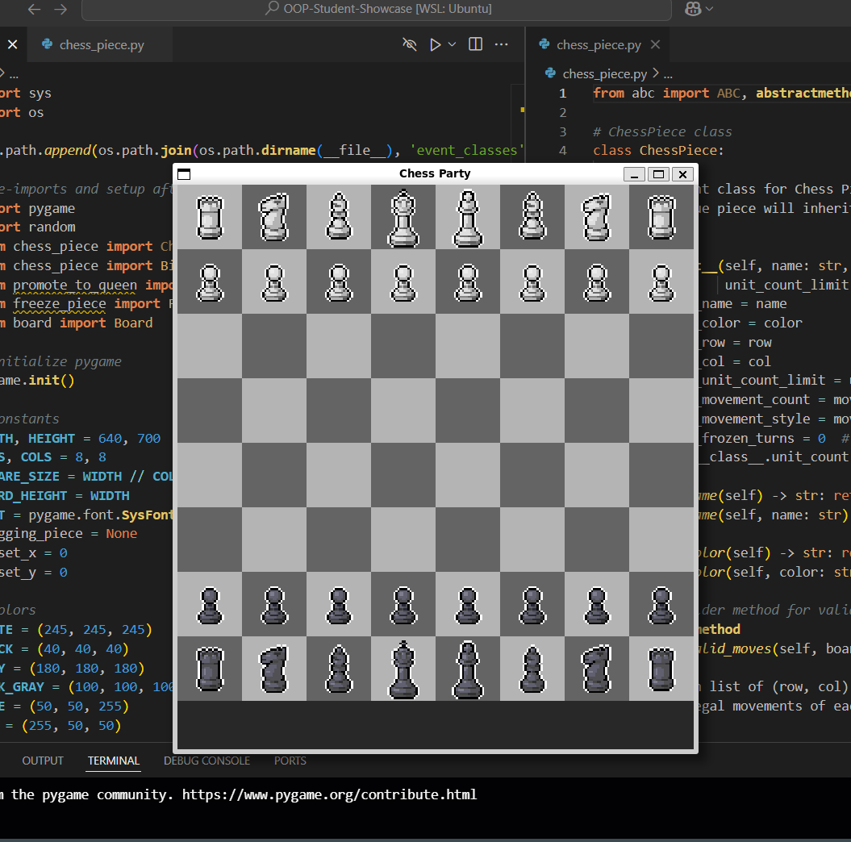
Initial Prototype
Deliverable
Zip of Whole Folder
Exe of Application
Issues
Unstable
Only 2 Events
Features
Works!
Clear Backend --> Easily Workable

Slide 14
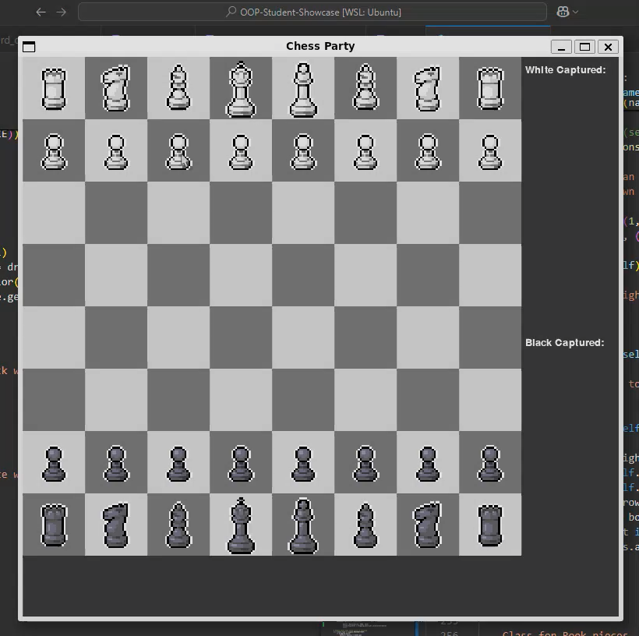
Additional Features
Display all captured pieces
Highlight legal moves
Victory screen
Turns

Slide 15
Lessons
Benefits to Modularization
Easy Modifications
Complete Control
Project Management
Planning
Task allocation
Branches

Slide 16
Thank you!
Live Demo Time!

